Slide 1
Discount Dinning

Slide 2

Group members
SAZZAD, MD. SABIR IBNA (16-31051-1)(DEVELOPER)
TASNIM FARHIN (16-31787-1)(TESTER)
AJMAIN,ENAN (16-33009-3)(DEVELOPER)
SARKAR,RAJDEEP (16-32874-3)(DESIGNER)

Slide 3
Problem Statement
Nowadays food business is very popular. But restaurants are not highlight because of less publicity and unplanned marketing.
So restaurant owners face a huge amount of loss and some cases owners put an end to their business.
On the other hand customers don’t get enough idea about new restaurants and don’t know where discount is more applicable.
So problem is for both restaurant owners and customers.

Slide 4
Time for solution

Slide 5
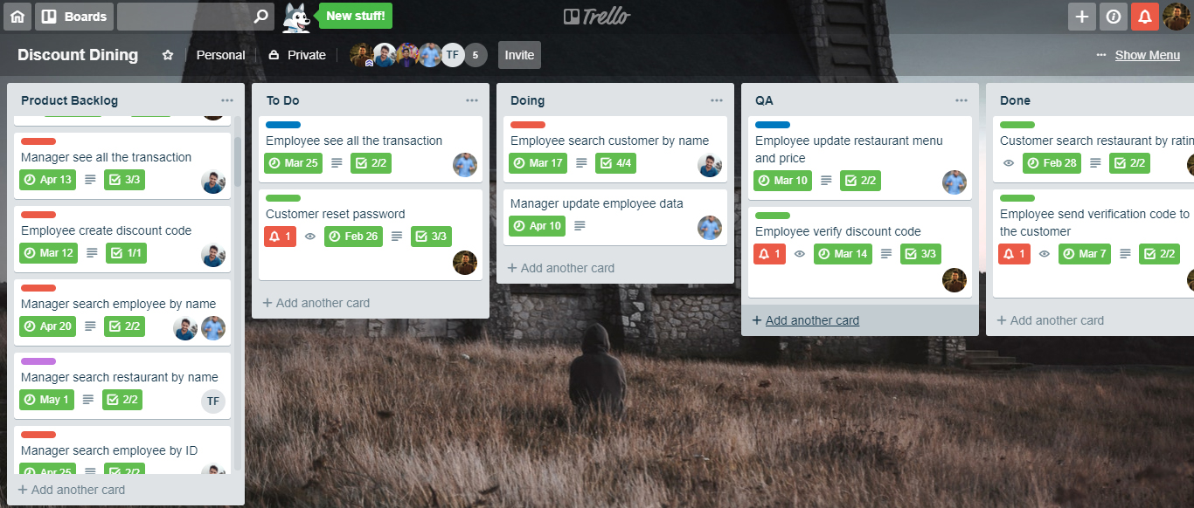
Sprint 1 Day 10

Slide 6
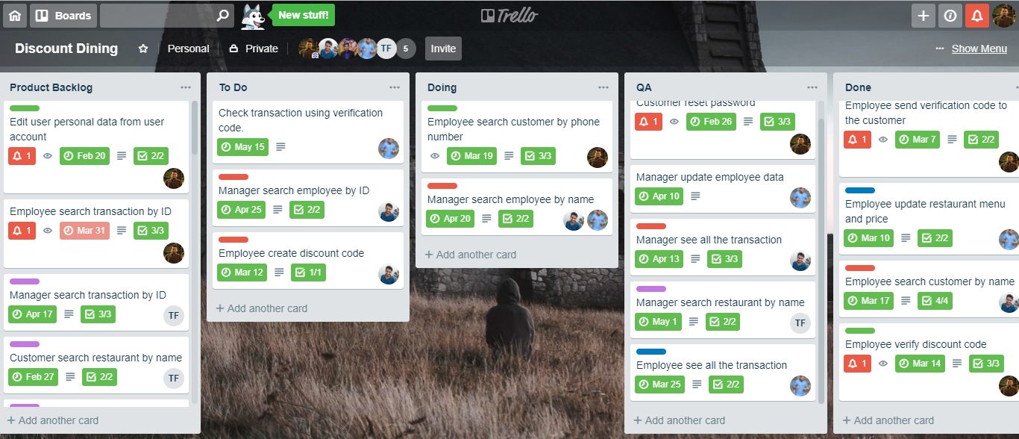
Sprint 2 Day 7

Slide 7
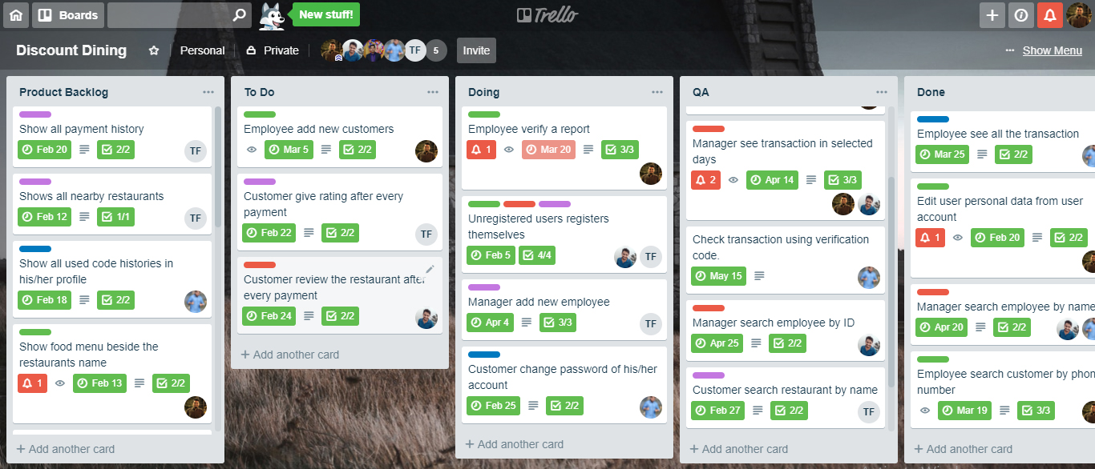
Sprint 3 Day 5

Slide 8
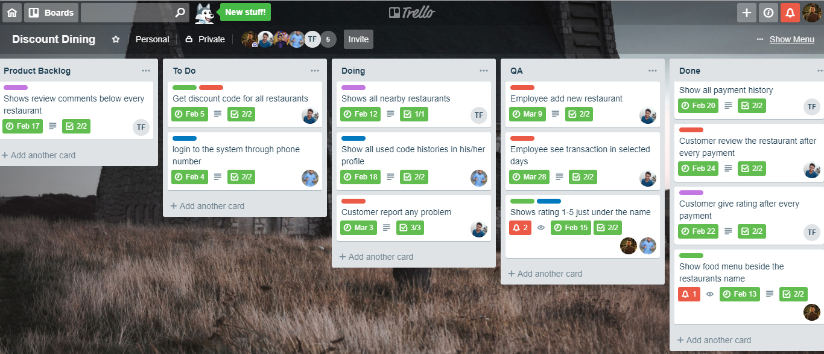
Sprint 4 Day 9

Slide 9
Thank you

